Slide 1

GOLD PRICE FORECASTING
Group 06
* ABHISHEK KUSHWAHA
* SHUBHAM GEETE
* LAXMIKANTA MOHAPATRA
* JYOTI GUPTA
* THOTE HARSHAL
* MADIGA POORNA CHANDRA
* YOGESH FULARI

Slide 2
Business Objective
Data provided is related to gold prices. The objective is to understand the underlying structure in the dataset and come up with a suitable forecasting model which can effectively forecast gold prices for next 30 days.
This forecast model will be used by gold exporting and gold importing companies to understand the metal price movements and accordingly set their revenue expectations.

Slide 3

Project Flow
Business Understanding
Data Preprocessing
EDA
Model Building
Model Evaluation
Deployment

Slide 4
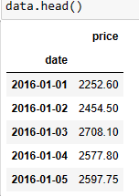
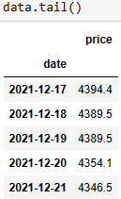
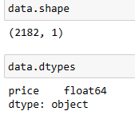

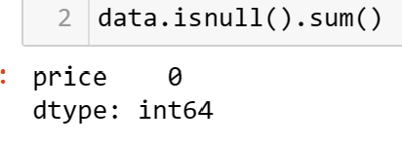
Data Collection and Understanding:
EDA
After collecting data its very important to understand your data.
The data set for the Gold Price Forecasting have 2182 rows and 1 column .
Shape of data after removing duplicates
Null Value Counts
Here we can see that there are no null values in the data set.
We have also checked for the duplicated data and found that there are few duplicated values.

Slide 5
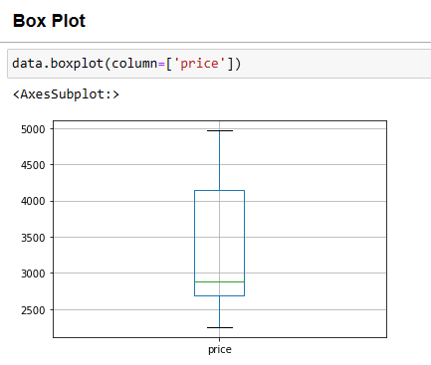
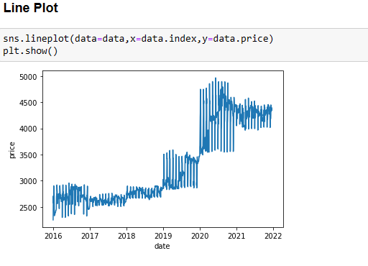
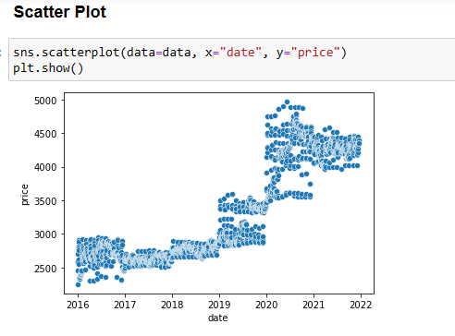
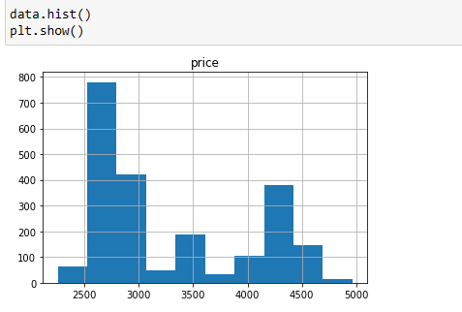
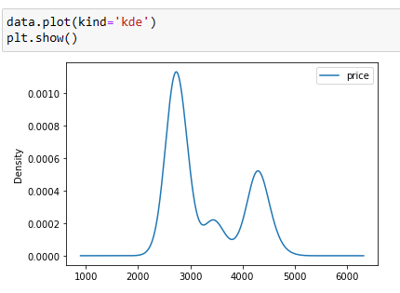
Data Visualization
From the Line plot and Scatter plot we can see that there is no such trend in the data. We can see that the price was quite in the same range between 2016-2019 and from 2020 there is gradual increase in the pricing.
From the Histogram and Kde plot we can see that the data is not normally distributed.

Slide 6
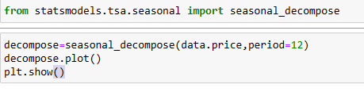
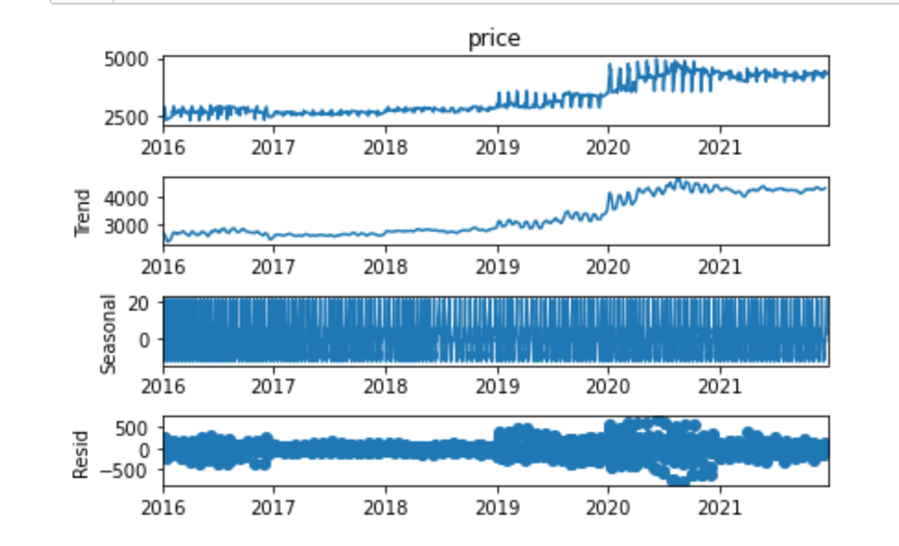
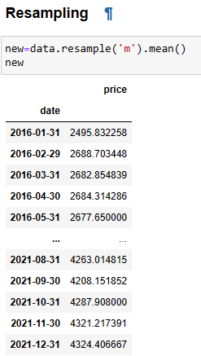
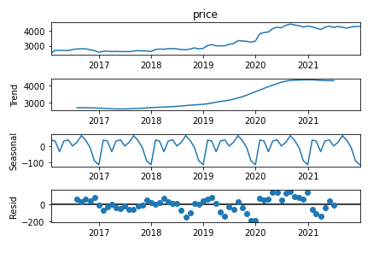
Seasonal Decomposition:- It helps us to better analyze the data and exploring different ways to solve the problem which involves breaking down Time Series data into many components or identifying seasonality and trend from a series of data.
Here we can see that the seasonality and residuals are quite dense and not that clear.
We have applied the resampling technique using mean and tried to plot the decomposition plot afterwards and the result is quite promising.
After resampling we can see that the seasonality and trend is quite clear.

Slide 7
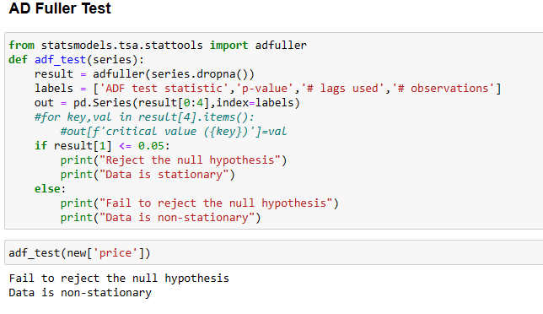
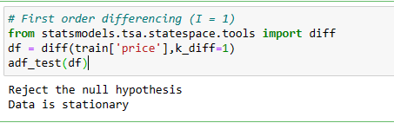
AD Fuller Test :-
Here from the AD Fuller Test we can see that the data is non stationary.
We have used the First Order Differencing to make the data Stationary which will be used in the Auto Regression Models.

Slide 8
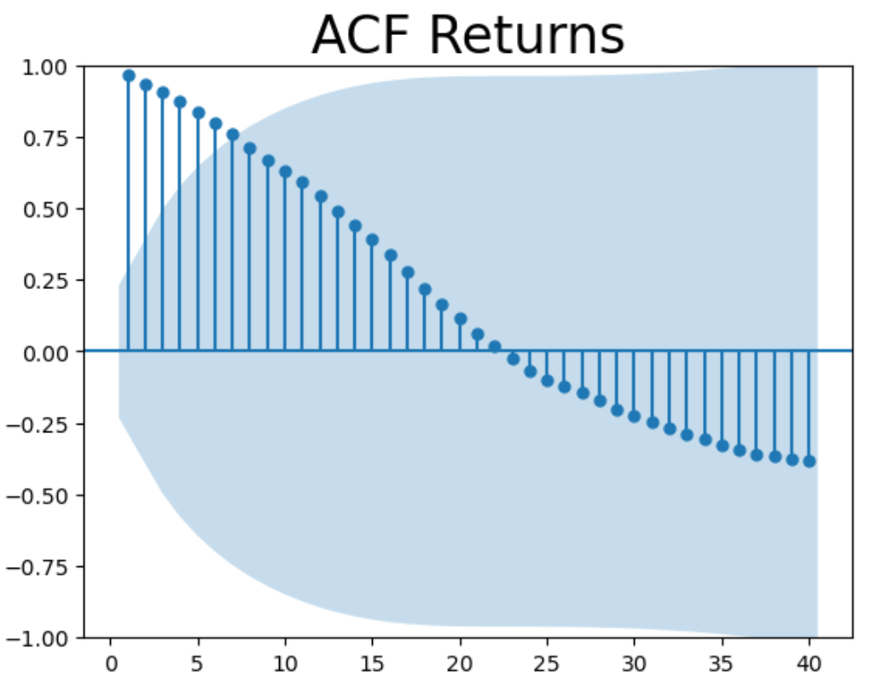
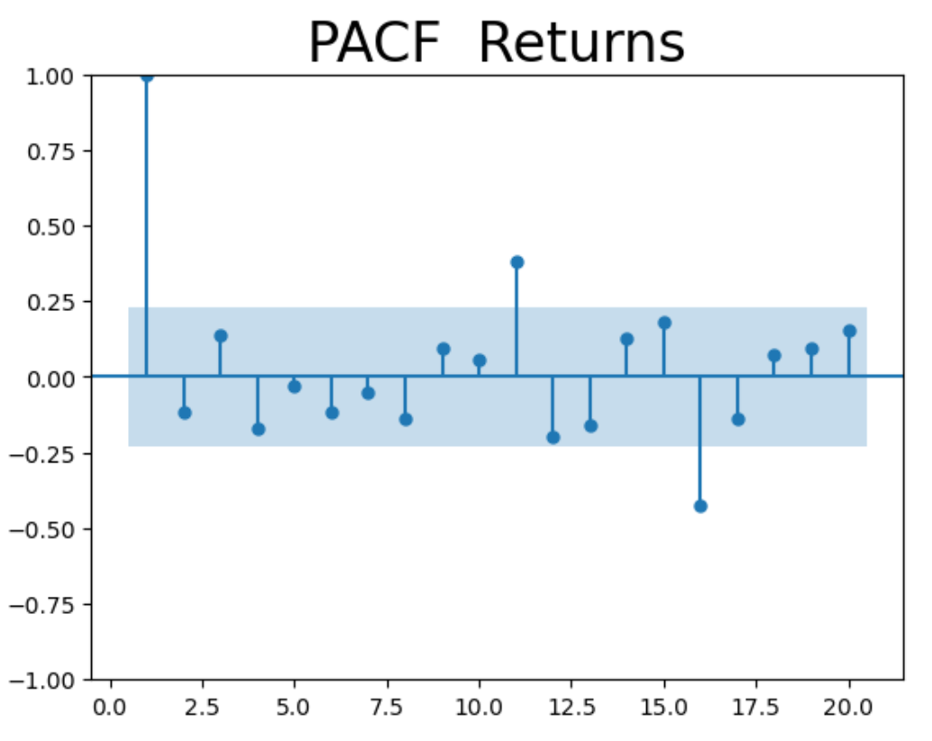
ACF & PACF
Autocorrelation Function (ACF) and Partial Autocorrelation Function (PACF) can provide valuable insights into the behavior of time series data. They are often used to decide the number of Autoregressive (AR) and Moving Average (MA) lags for the ARIMA models. Moreover, they can also help detect any seasonality within the data.

Slide 9
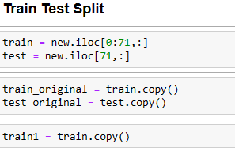
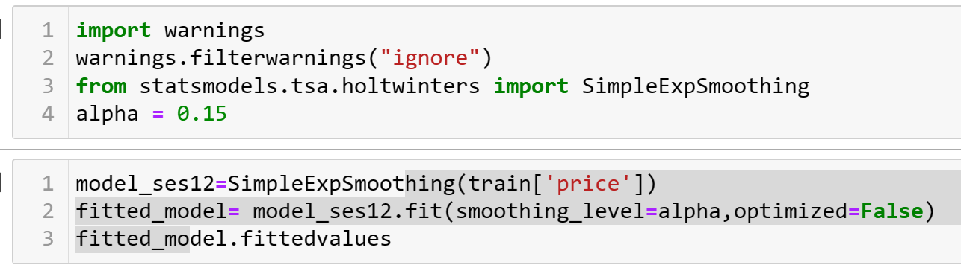
Model Building
Here we have divided the data to Train and Test data.
Simple Exponential Smoothing :

Slide 10
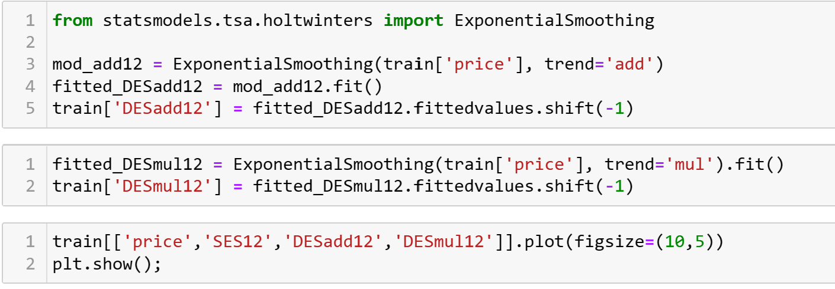
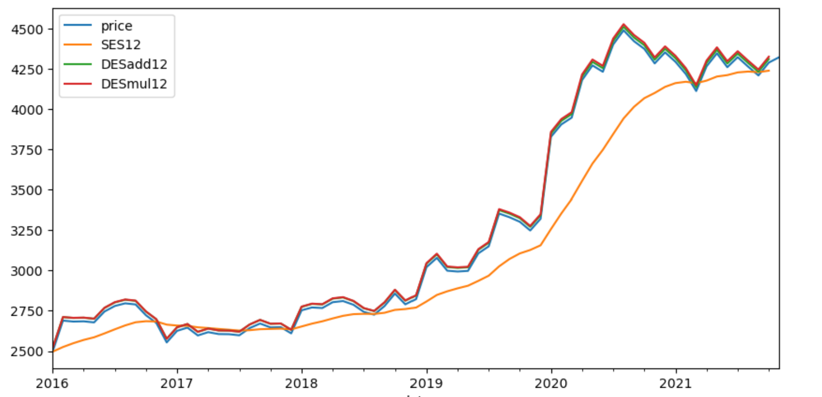
Double Exponential Smoothing :

Slide 11
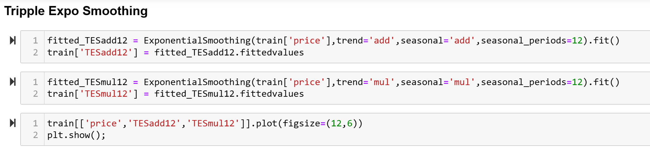
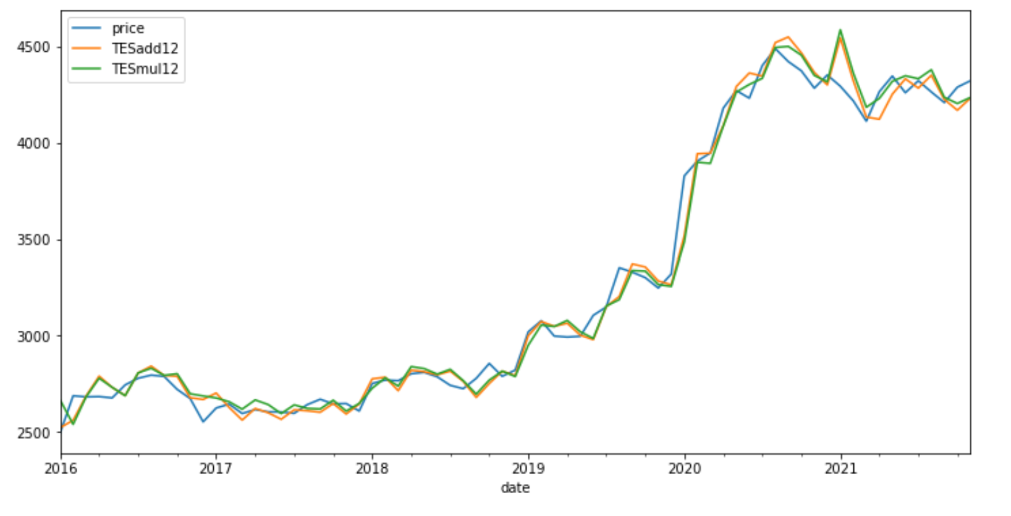
Triple Exponential Smoothing

Slide 12
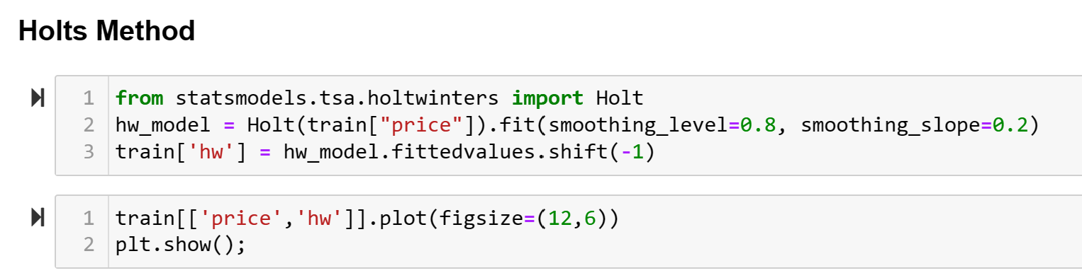
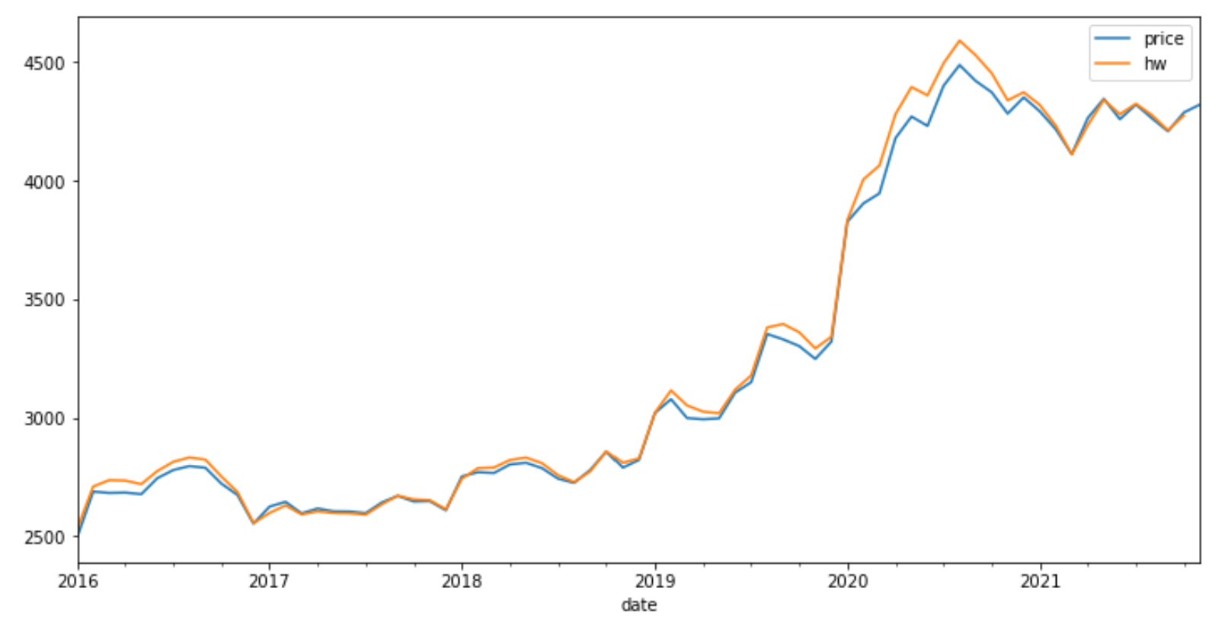
Holts’s Method :

Slide 13
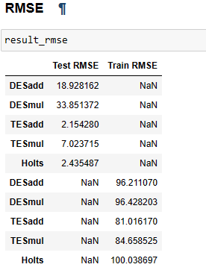
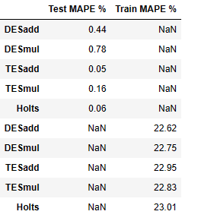
Model Evaluation :
Here in the Model Evaluation part we have used the RMSE method as well as MAPE method.
RMSE measures the average difference between values predicted by a model and the actual values.
MAPE defines the accuracy of forecasting method. It represents the average of the absolute percentage errors of each entry in a dataset to calculate, how accurate the forecasted quantities were in comparison with the actual quantities
Here we can see the TESadd gives the lowest RMSE value for both train and test data.
Here we can see that the lowest MAPE for Test and Train data comes up for the TESadd.

Slide 14
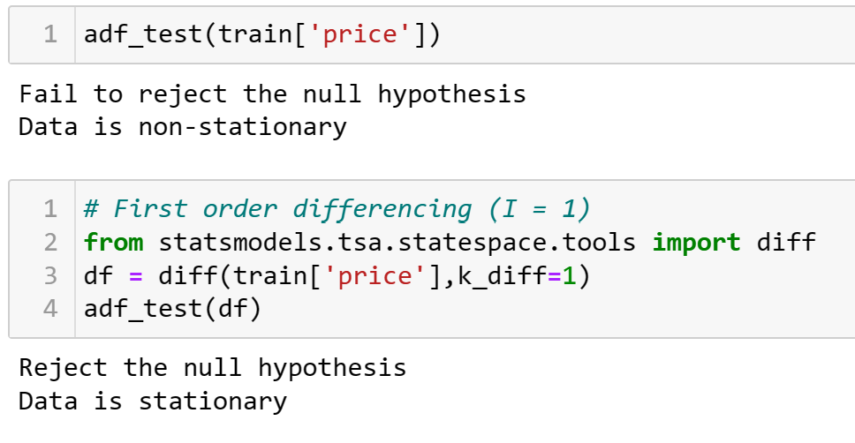
Auto Regression Models :
ARIMA
Auto ARIMA
SARIMAX

Slide 15
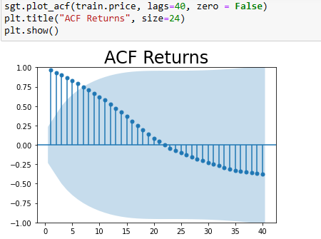
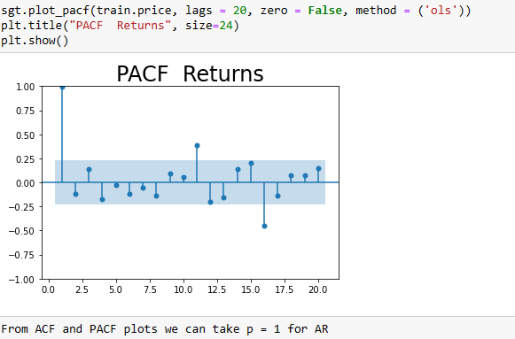
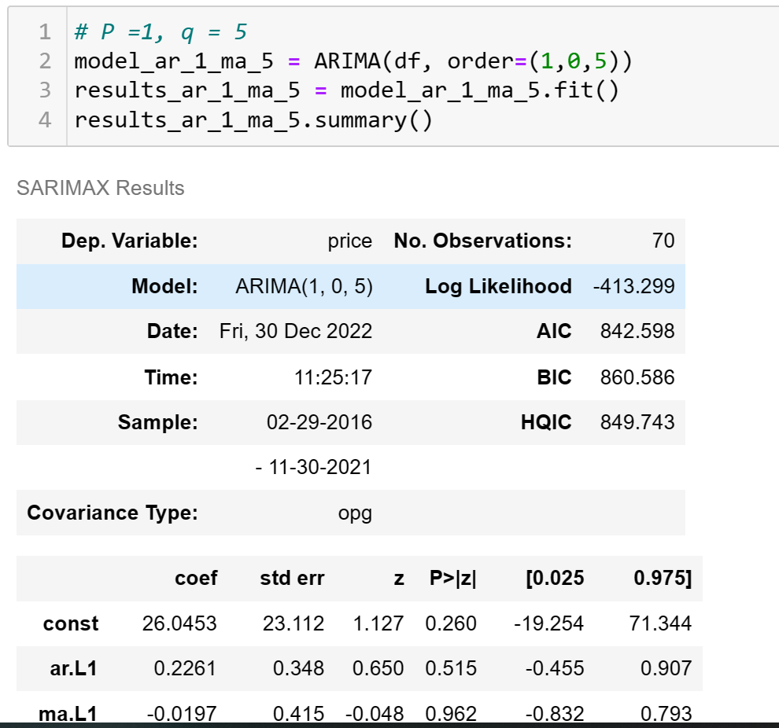
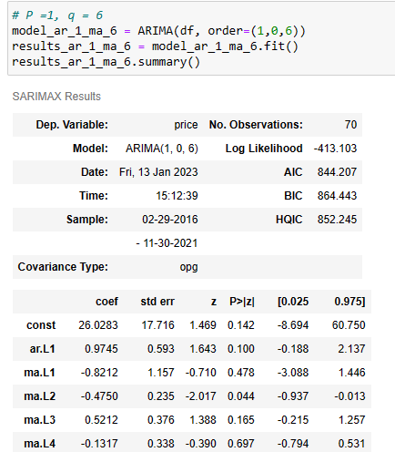
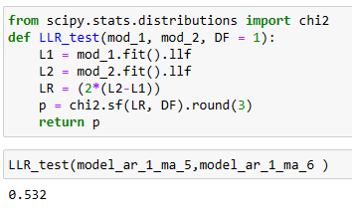
ARIMA Model :
From ACF & PACF we have taken the value of p as 1 and tried to build model for the order of (1,0,5) & (1,0,6) and compared the two by performing the LLR test.
In LLR test if the value comes to 0 or near to o then there is improvement in model. Here as the result is 0.532 , there is no improvement.

Slide 16
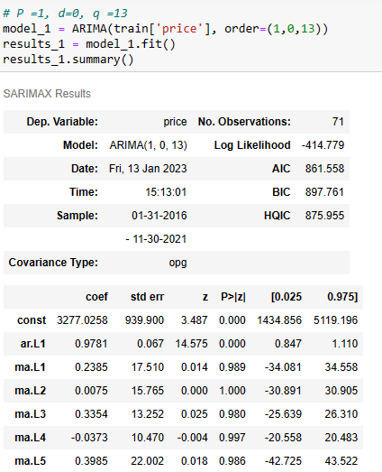
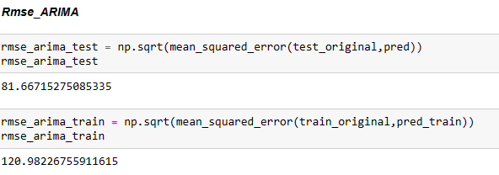
As there is no improvement in the 2nd ARIMA model, to tackle that we have taken all the possible ranges for the p,q and d AND tried to calculate the MSE values and found out that value for MSE with the order of p=1,d=0,q=13 is least. Now we have tried the same in our ARIMA model and calculated the RMSE value of the model.
Comparing with Triple Exponential Model with Additive trend , RMSE of ARIMA model is higher

Slide 17
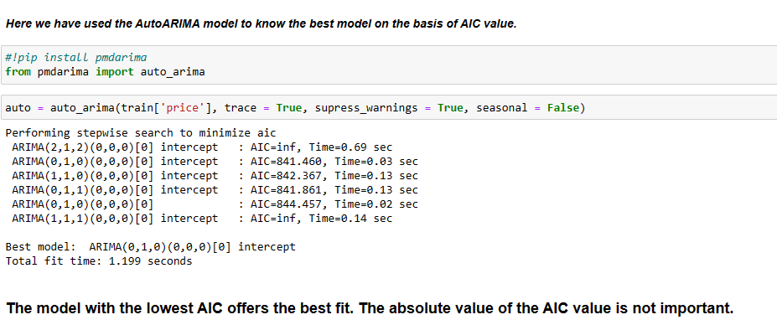
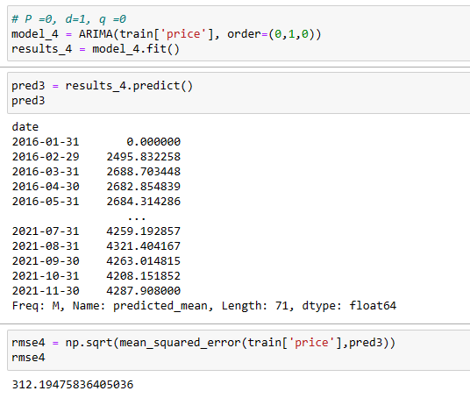
Auto ARIMA
In the basis of AIC value we have found out the order for p,d,q would be (0,1,0 ) and we have tried that in the model and calculated the RMSE value which comes as 312.19 which is quite high.

Slide 18
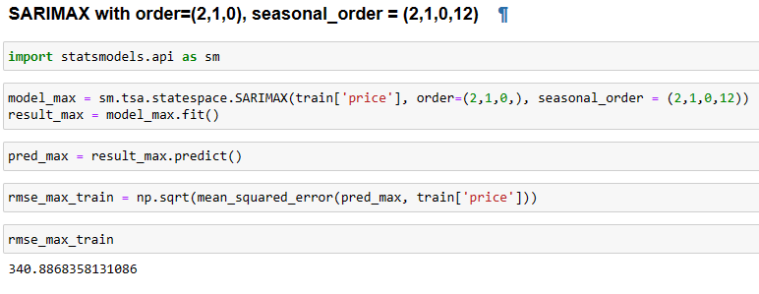
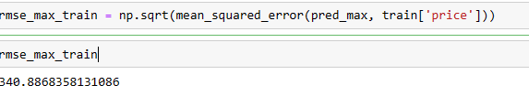
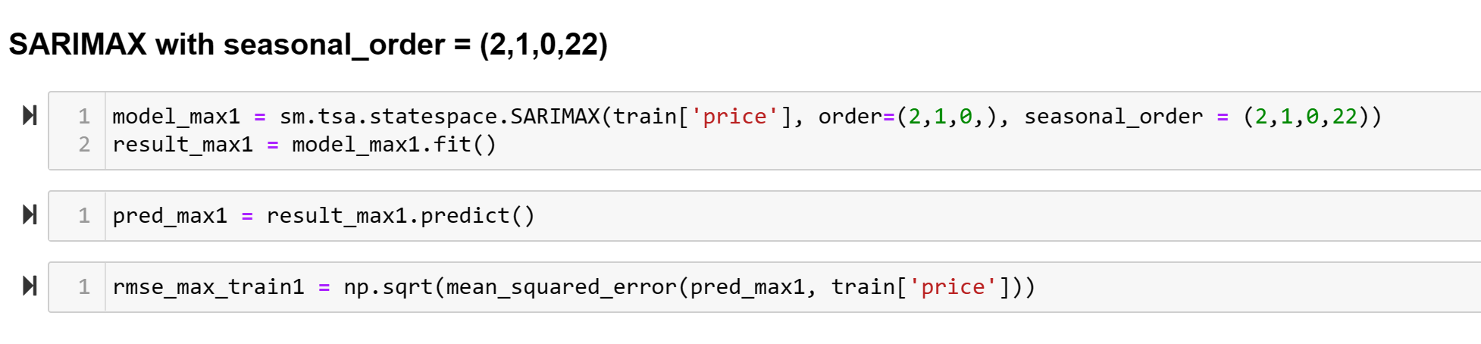
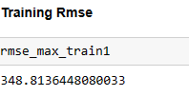
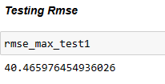
SARIMAX Model :

Slide 19
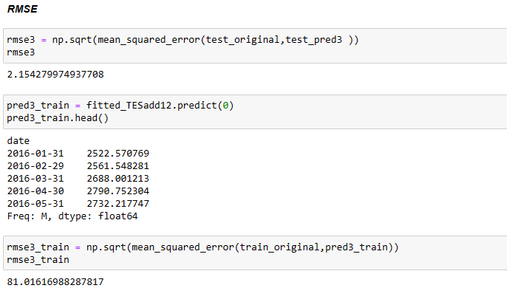
Best Model
After comparing all the models we have found out that the Triple exponential smoothing model with trend and seasonality as additive is the best model as it gives the lowest RMSE VALUE.

Slide 20
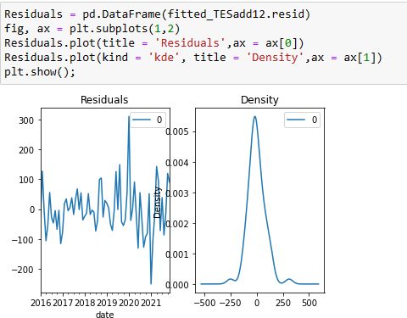
Residual Analysis
There is no such trend pattern in the residual analysis plot as well as from the density plot we can confirm that the data is normally distributed which is why our model is less prone to errors.

Slide 21
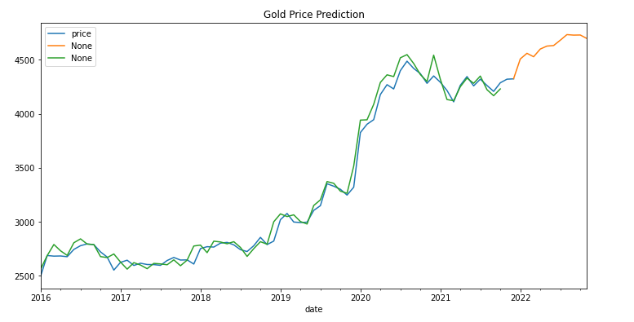
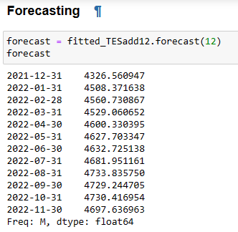
Forecasting -

Slide 22
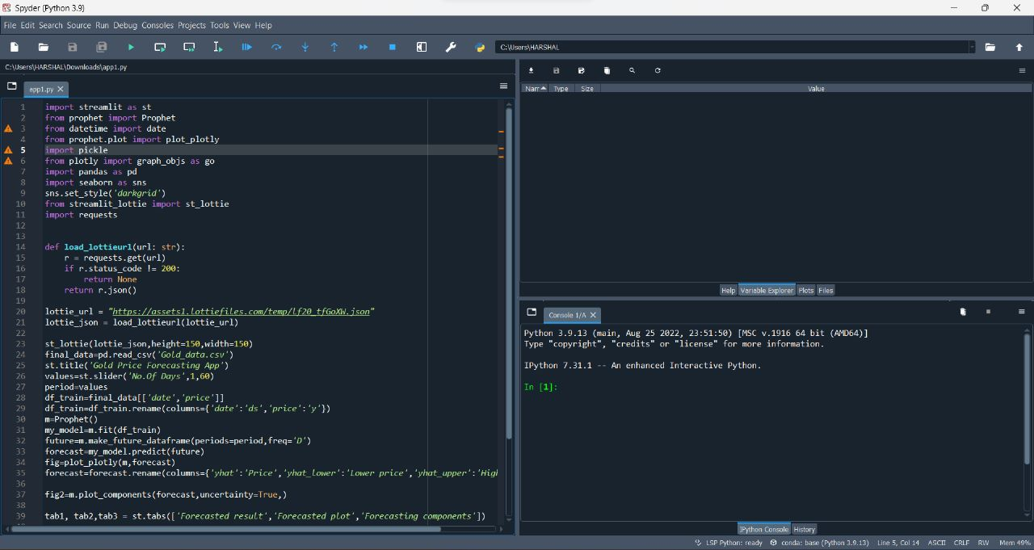
Deployment

Slide 23
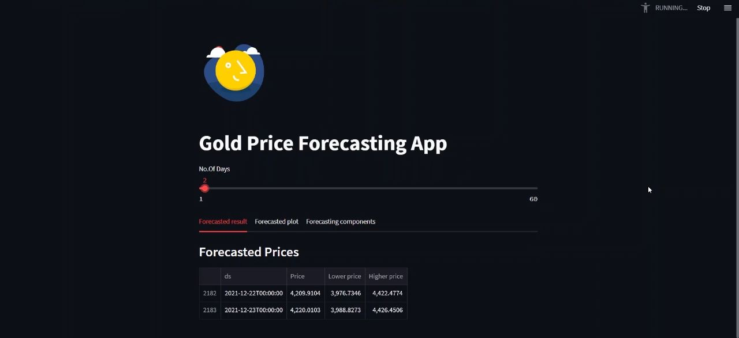
Deployment

Slide 24
Thank you!

